Slide 1
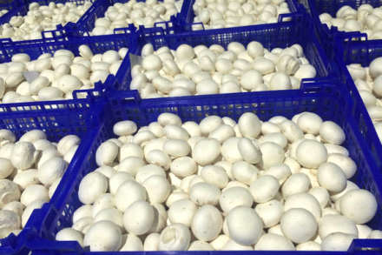
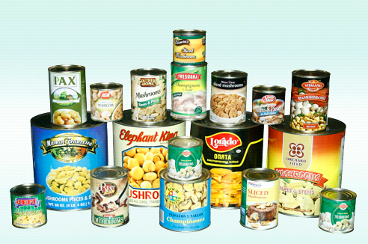
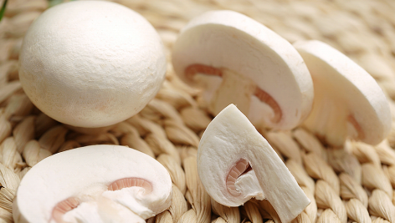
Jiangsu Yuguan Modern Agricultural
http://www.yuguanchina.com
YUGUAN MUSHROOM
How To Build and Run A Mushroom Farm
-Some experience from China
Jackie QI
Director/Executive VP
Notes:
说明：
1.右键点击图片，点击“更改图片”，图片原有动画效果不变。
2.适当拉伸、剪裁图片可以达到更好的效果。
3.音乐删除或更改：点击菜单栏“切换”-右上角“声音”，即可以删除或更改音乐了。

Slide 2
目录 Contents
01
Brief Introduction
02
Build a farm from zero
03
How to run a big farm
04
Some thoughts of future

Slide 3
01
项目整体介绍
Overall Project Introduction

Slide 4
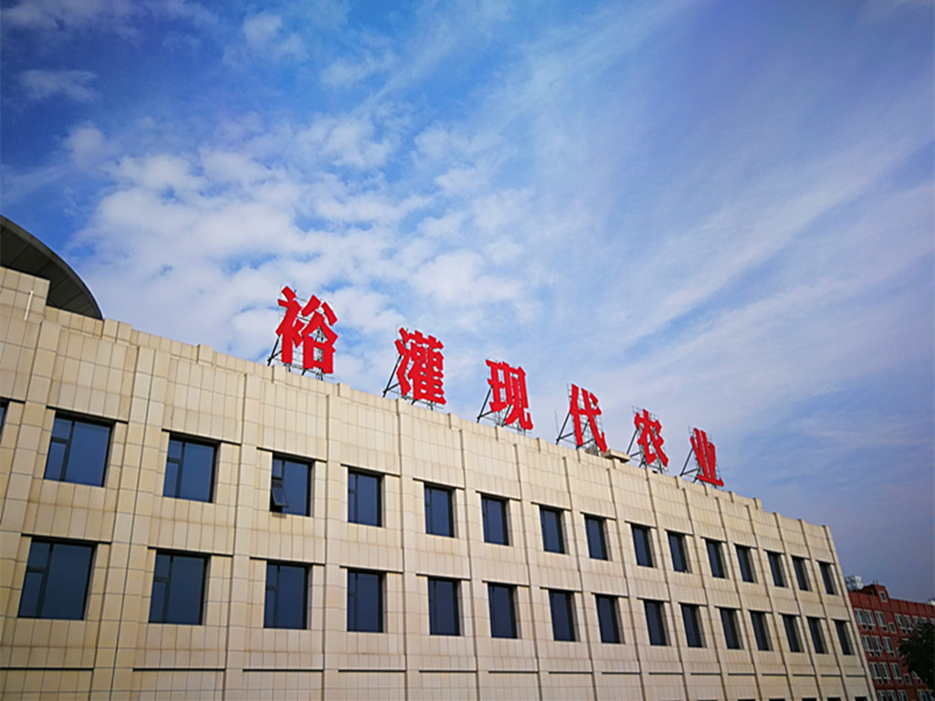
裕灌现代农业介绍
Yuguan
Located in harbor town of Guannan, Jiangsu Province, China.
Founded in October 2010, so far the biggest and most modern agaricus farm in China
Also the biggest integrated mushroom farm in single location globally
Jiangsu Yuguan Modern Agricultural S&T Co.,Ltd.

Slide 5
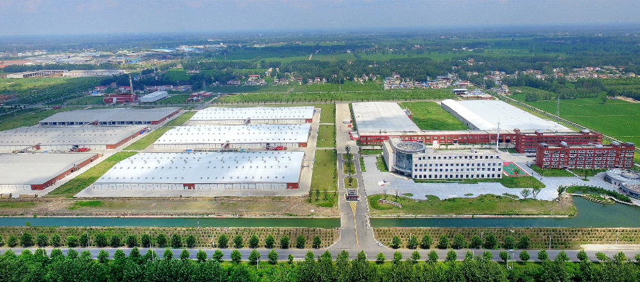
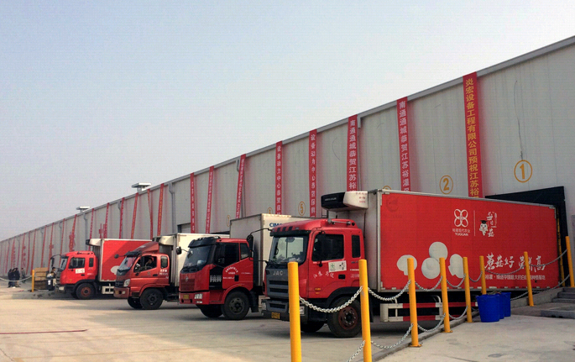
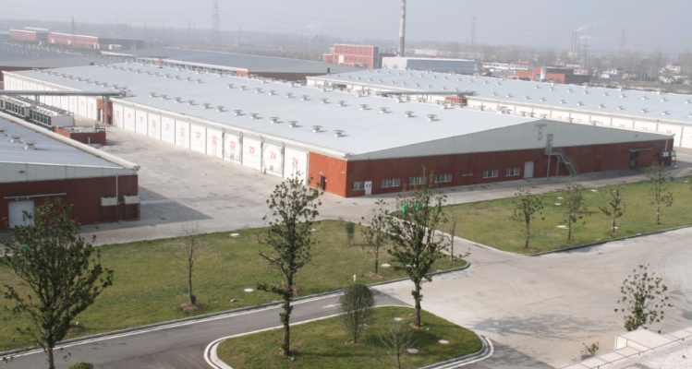
裕灌现代农业介绍
Yuguan Modern Agricultural
Investment $200 million, 215 acres
Fully integrated from compost, growing, fresh pack to processing
170,000 tons of PIII compost, 60,000 tons mushroom
produce 100,000 tons mushroom after expansion
Yuguan Modern Agricultural Park

Slide 6
裕灌现代农业介绍
Gamer changer in Chinese mushroom industry
Composting: traditional Phase I to 100% Phase III
Growing: seasonal 1 crop/year to year-round 8.7 crops/year
Logistics: regular trucks to complete cold chain
Food safety: no control to full traceability and organic standard

Slide 7
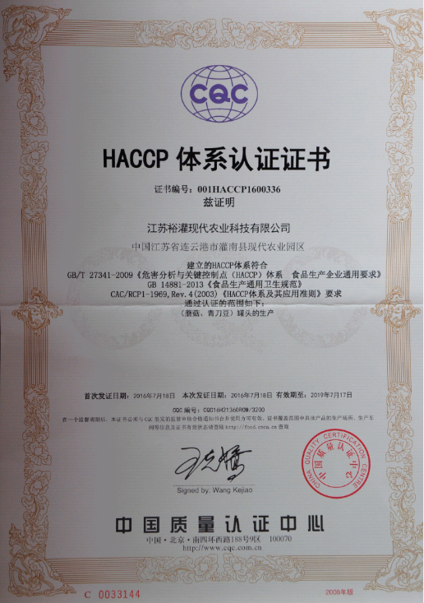
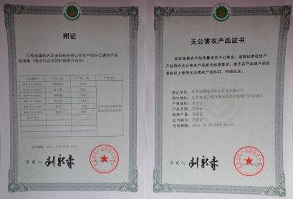
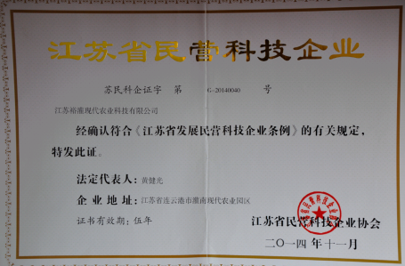
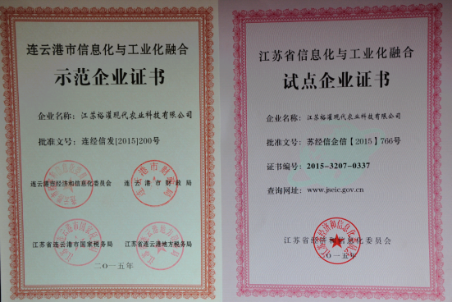
裕灌现代农业介绍
Enterprise Honors
HACCP certified
FDA certified
GAP Certified
Famous Brand of China
Hi-Tech Agricultural enterprise
Green Foods
Organic Certificates

Slide 8
02
建设裕灌的心路历程
Why we built such a farm in China

Slide 9
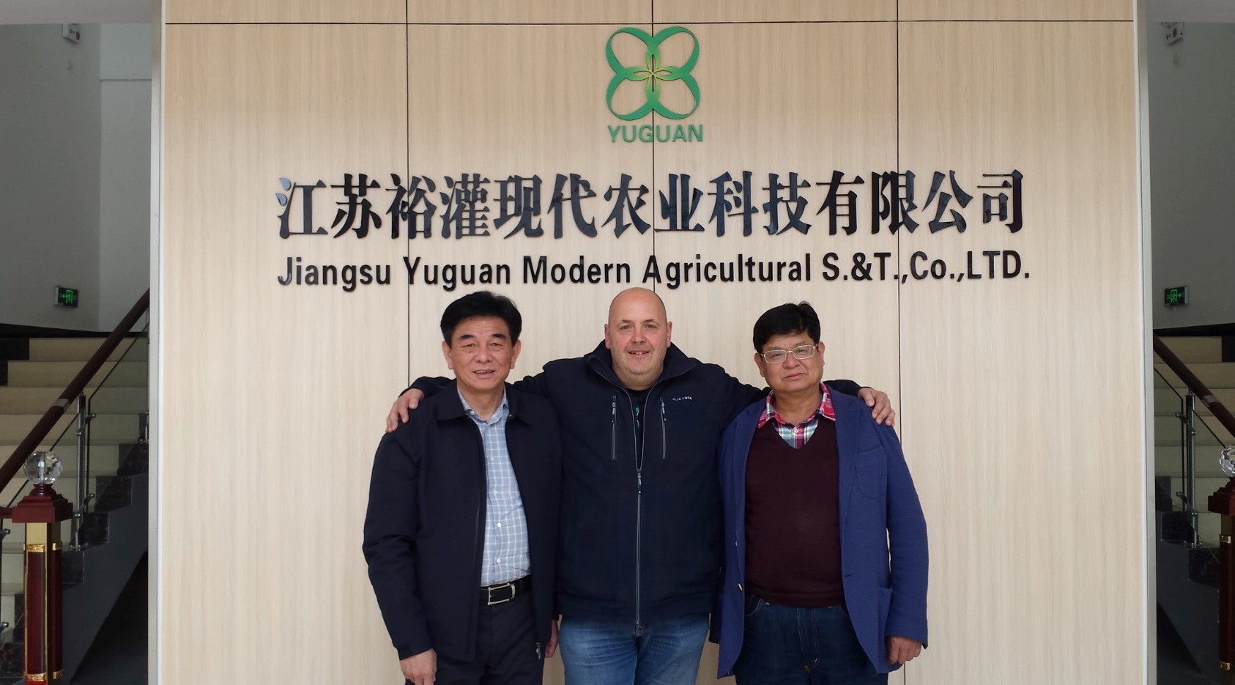
三十年的蘑菇情怀
30 years of mushroom passion
Starting from a humble brine mushroom processor to biggest mushroom cannery, producing 50,000 tons annually
First to win anti-dumping case and bring Chinese mushroom to American market
“Mr. Yellow”, King of mushroom in China

Slide 10
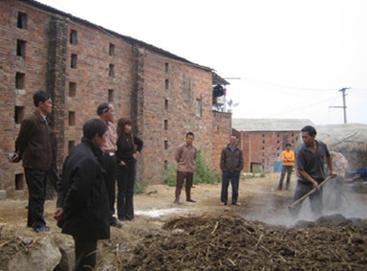
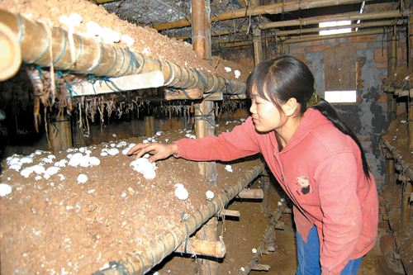
出口的挑战
···

Slide 11
危机中存变革
In prosperity think of adversity
Keen insight of the domestic mushroom change-when butterfly flaps its wings in 2008
Our choice: build the best farm and grow the safest mushroom in China

Slide 12
现实的挑战
Location
Knowledge
Funding
Talent

Slide 13
现实的挑战
Preparedness ensures success, unpreparedness spells failure
Location: raw material, logistics, climate
Knowledge: farm visits, experts
Funding: $200 million secured
Talent: start from blank slate paper

Slide 14
建设
Knowledge
Work with the best

Slide 15
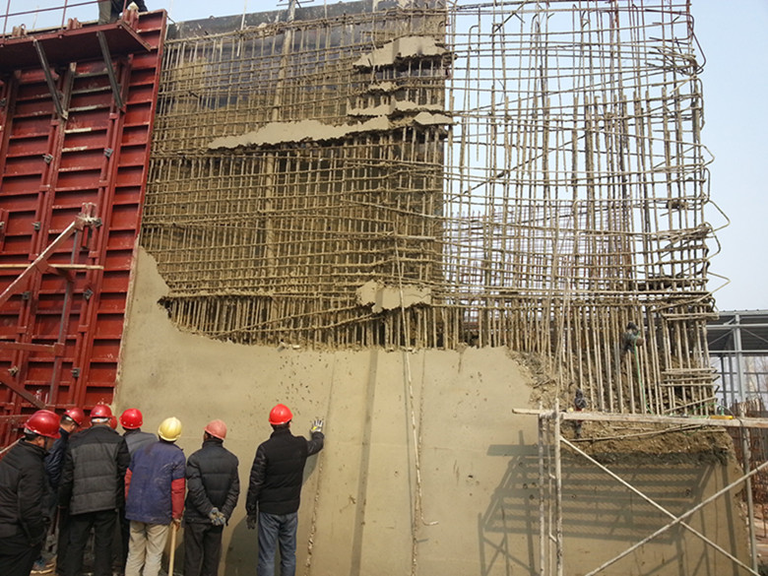
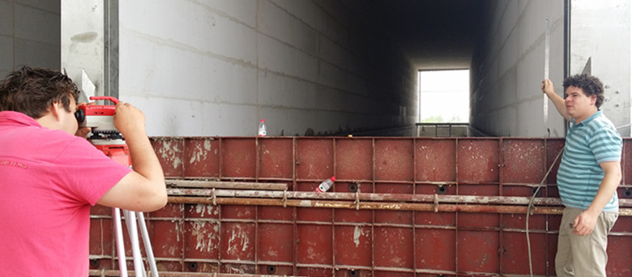
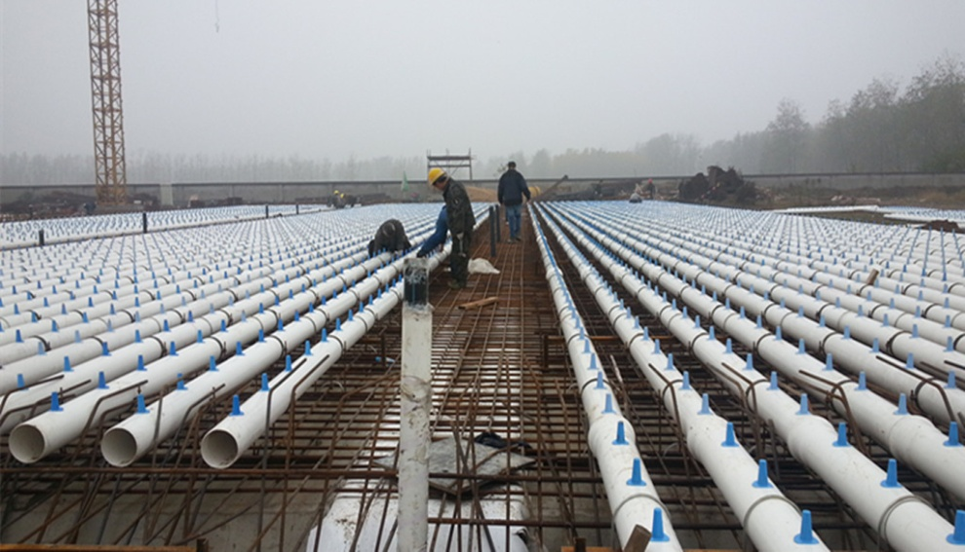
建设
Building-
Detail is the devil
Difference in climate, soil condition, regulation
Different building material
It is NOT agri project

Slide 16
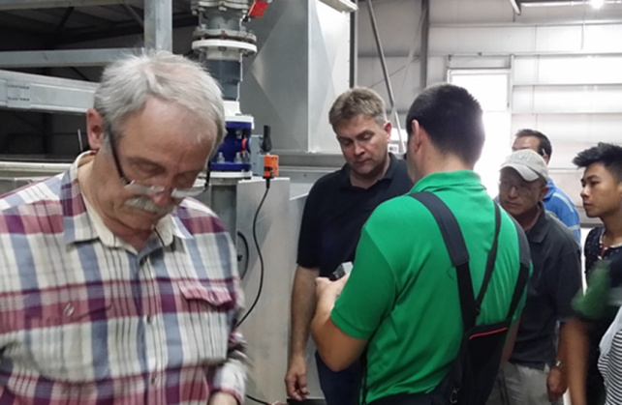
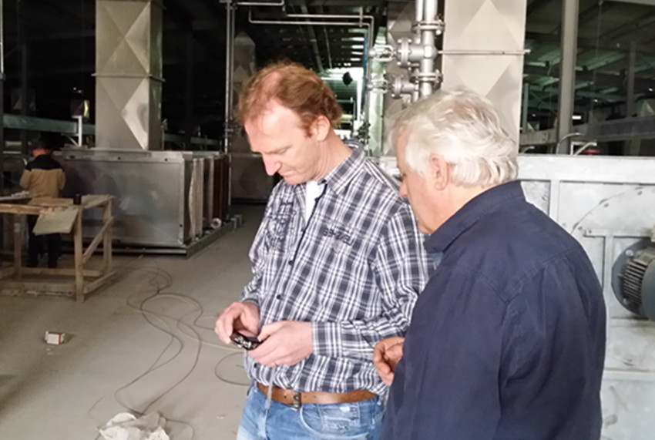
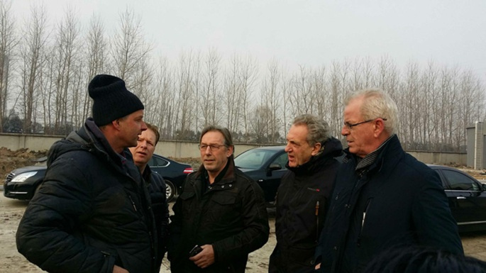
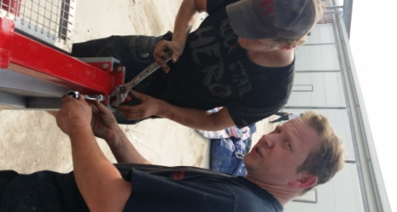
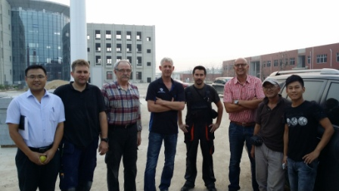
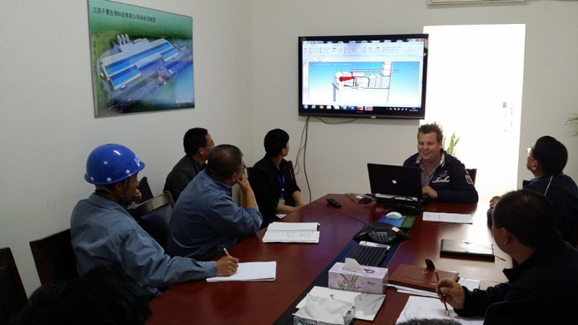
安装
Installation
1000 days on site
multi-national forces
make perfection more perfect

Slide 17
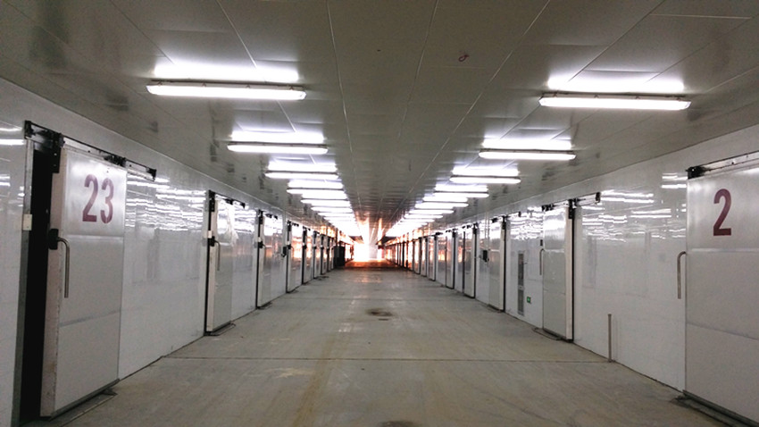
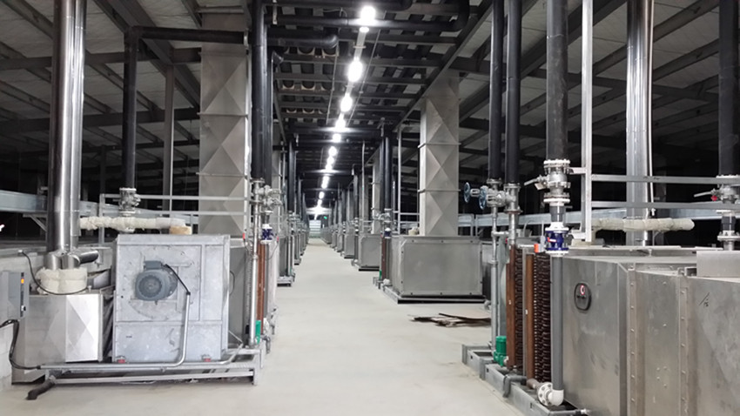
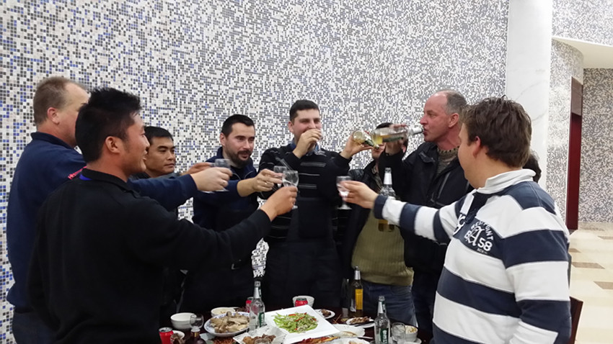
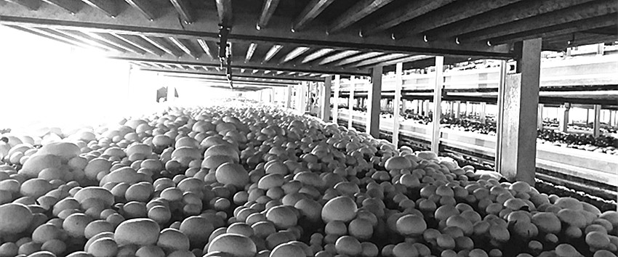
投产
Start up
November 2014
9 bunkers, 31 tunnels
Vodka for success in one stroke

Slide 18
03
运营裕灌的得失心得
A look back at the operations

Slide 19
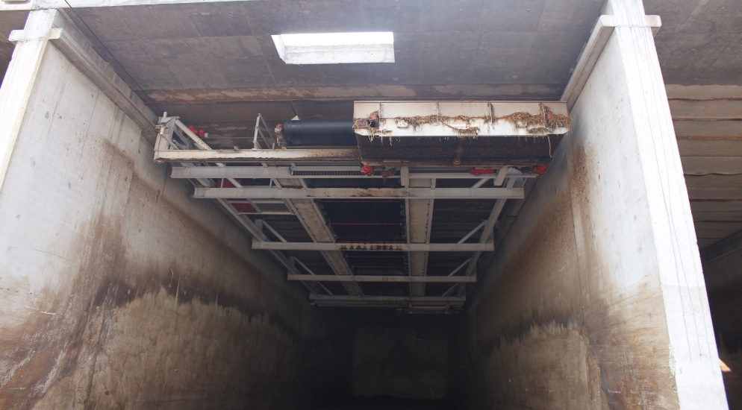
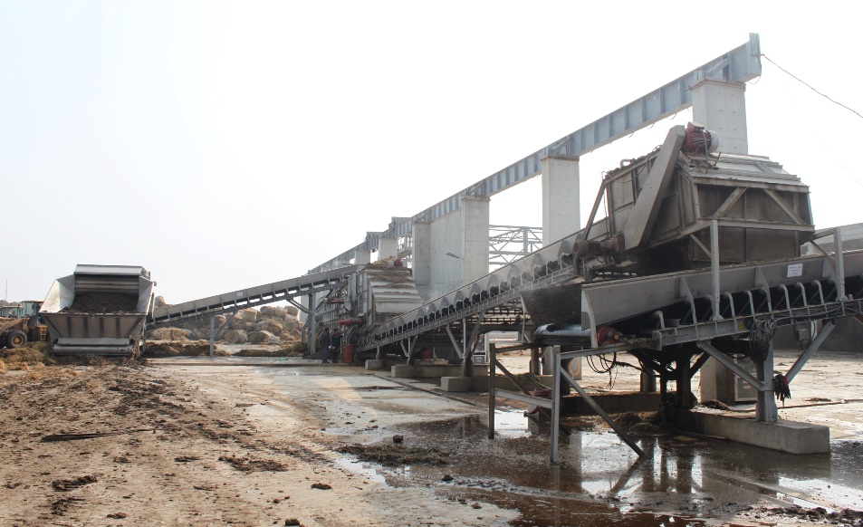
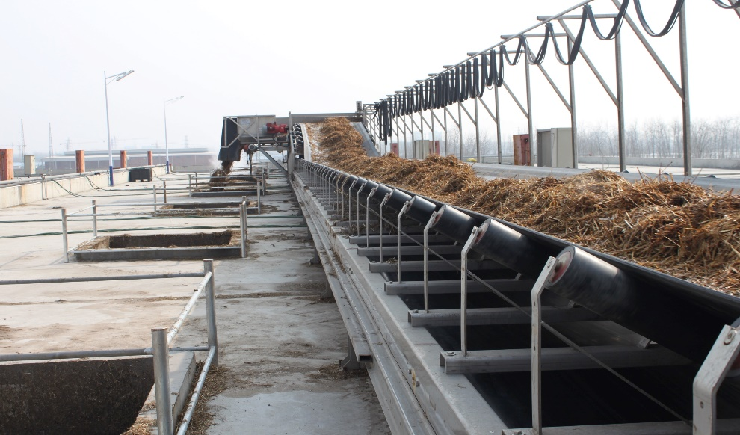
生产工艺
Bunker
18 bunkers x 1000 tons
Overhead filling +computer
5,000 tons of Phase I weekly

Slide 20
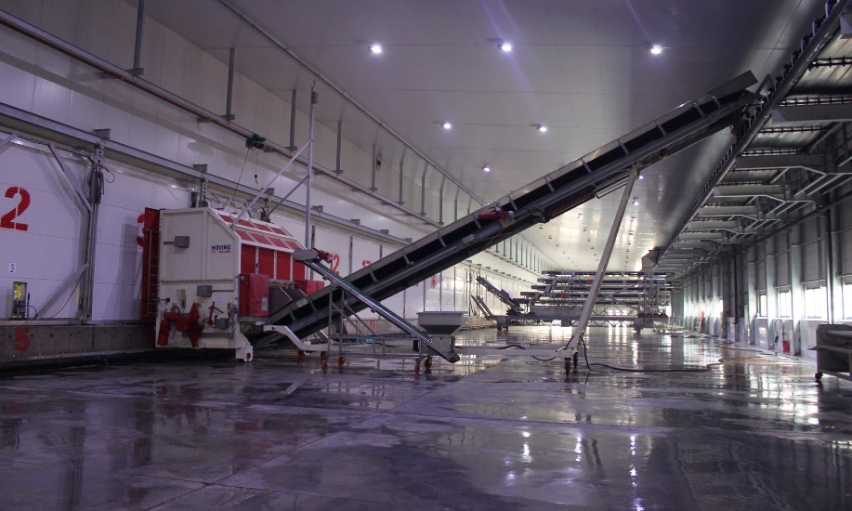
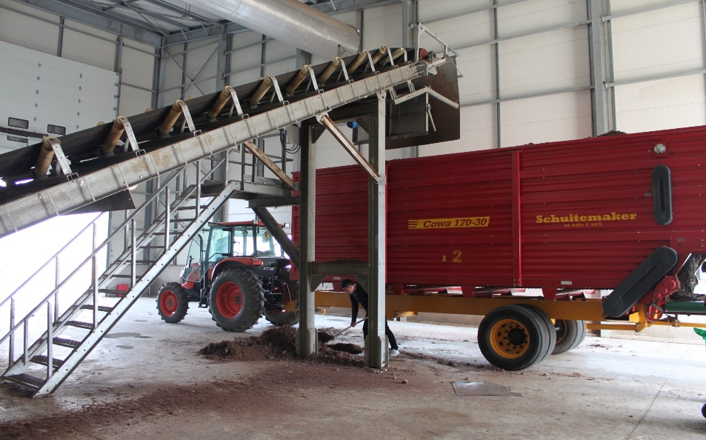
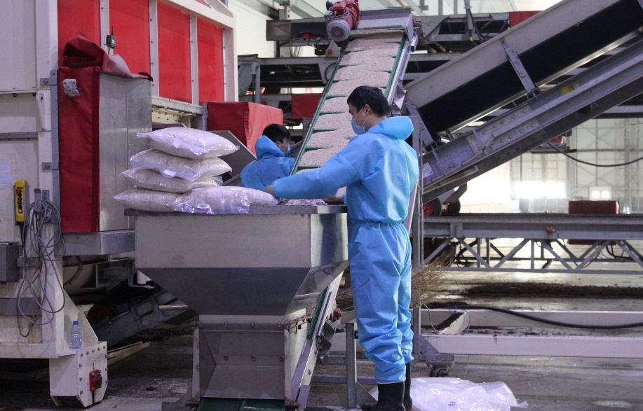
生产工艺
Tunnels
62 Phase 2&3 tunnels
Double sided +hygiene
3,200 tons of Phase III weekly

Slide 21
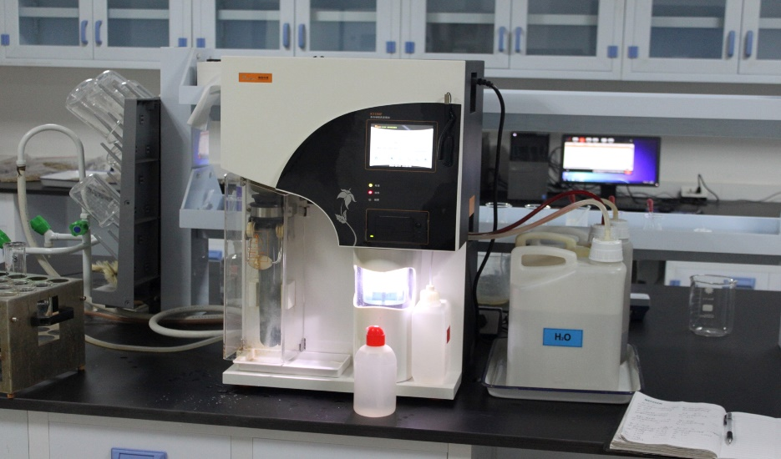
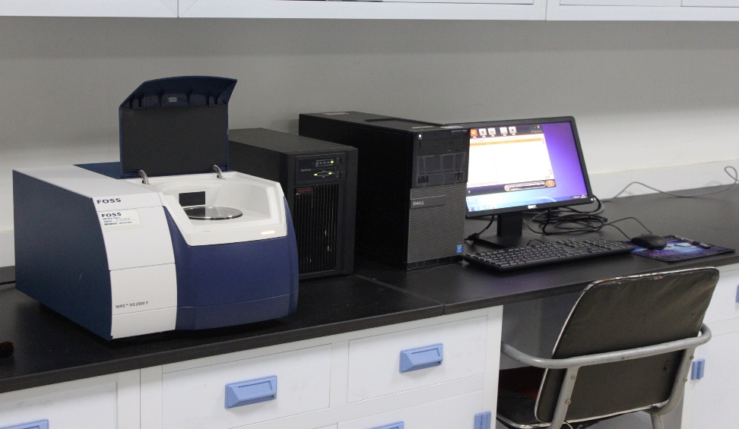
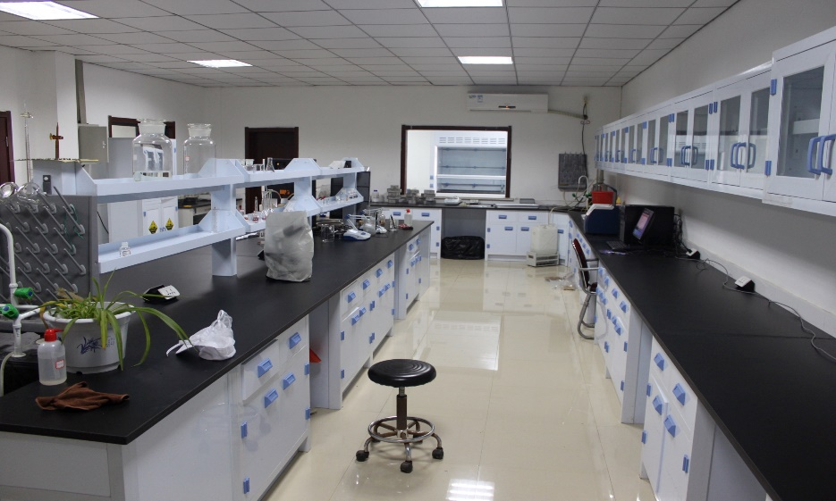
生产工艺
Quality control
Chemical and biological labs
Dual system of wet lab and NIR
Full traceability of all raw material

Slide 22
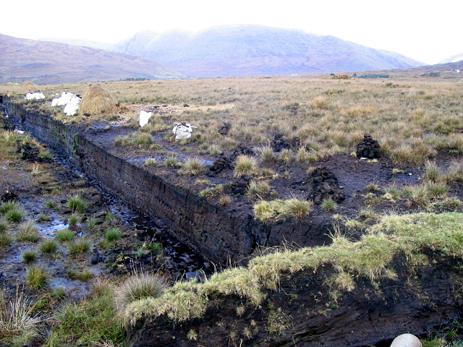
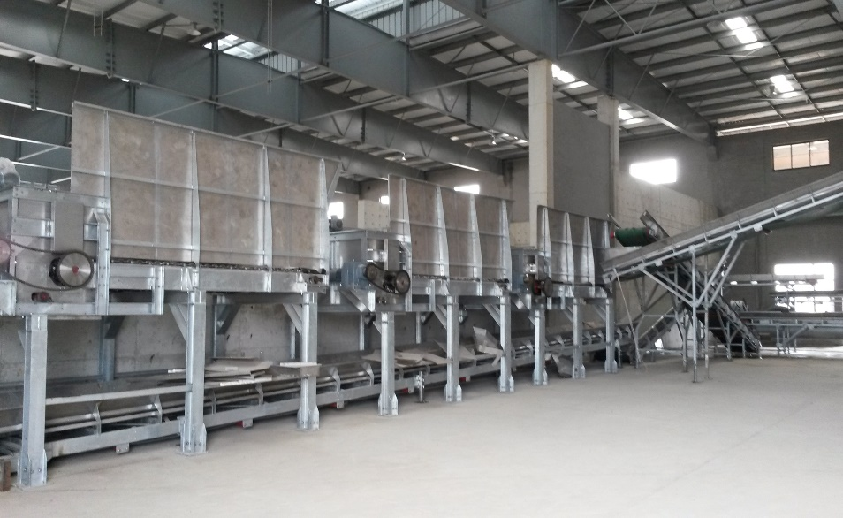
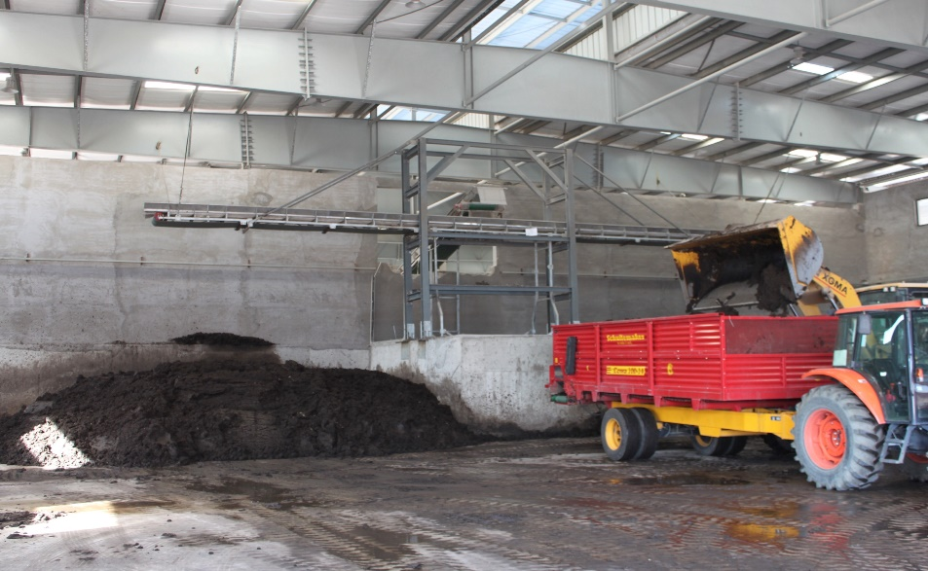
生产工艺
Casing
Start from the peat bog
Different recipe for different
product / season

Slide 23
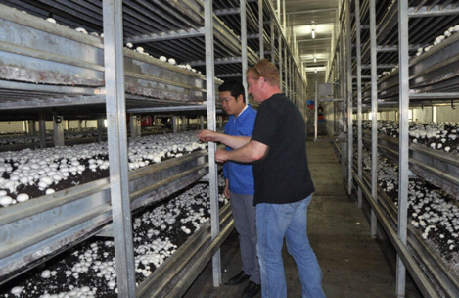
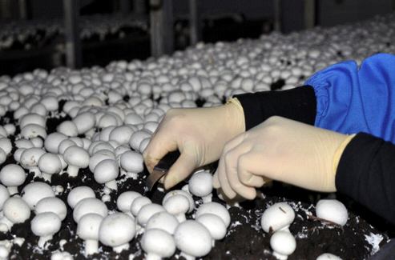
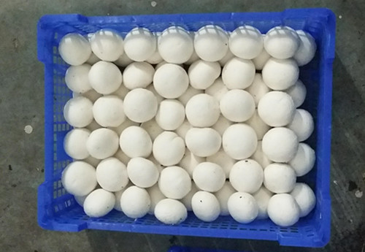
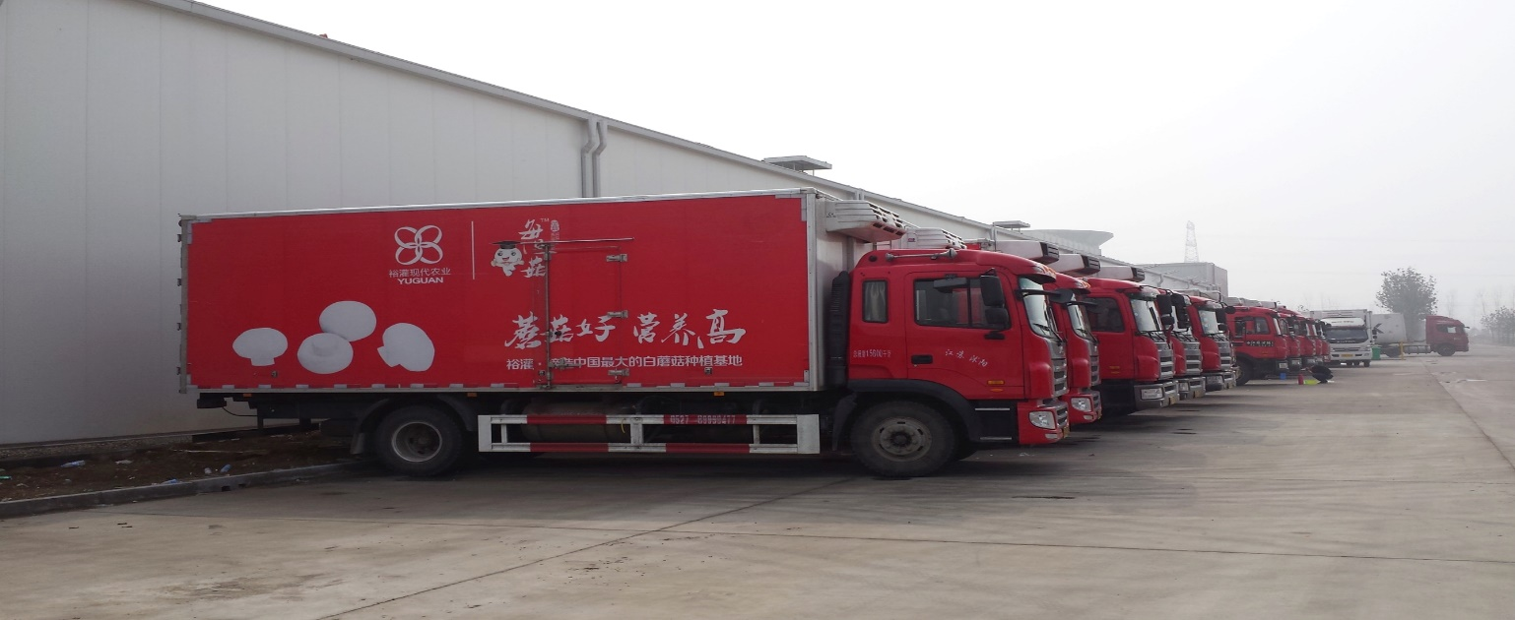
生产工艺
Growing
144 rooms, 1075m² each
Auto watering, organic growing
800+ pickers
Full-course cold chain

Slide 24
经验教训
Raw
material
Disease
R&D
Team

Slide 25
努力的目标
Yield / quality
Performance
Recipe
Process
Patent
Trace
Safety
。
。
。
Training
KPI
Bench
Habit
Learning oriented team
。
。
。

Slide 26
04
双孢菇行业发展的思考
Some thoughts about industry development

Slide 27
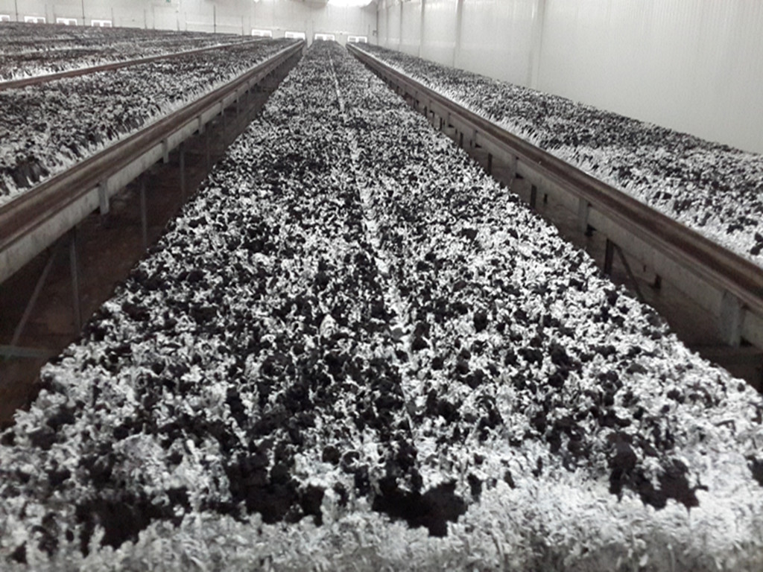
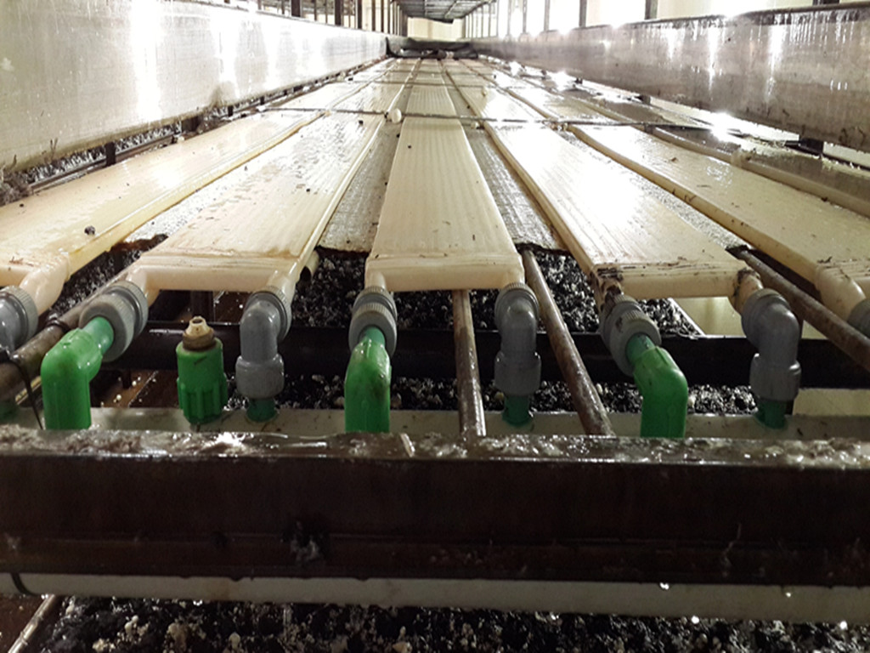
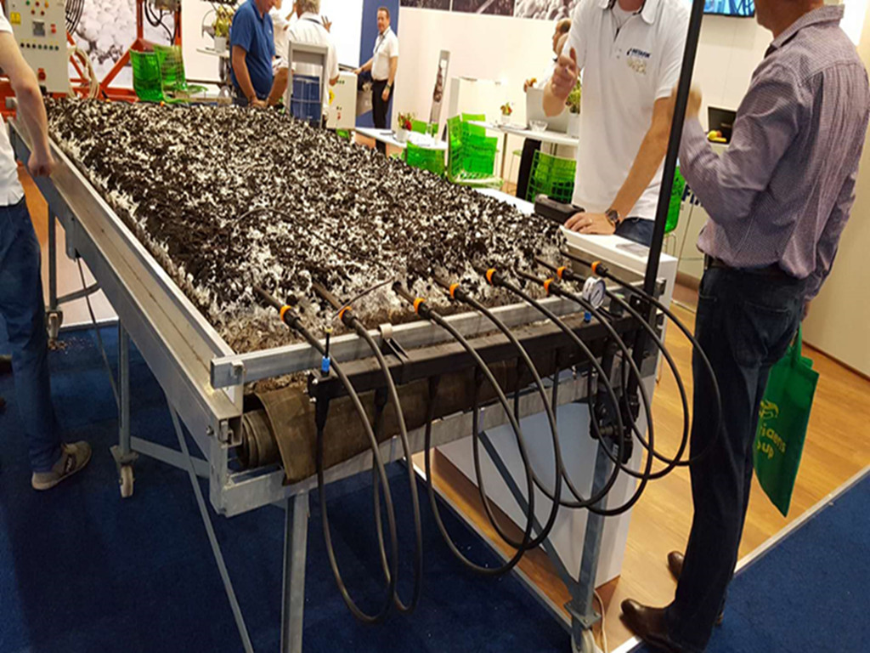
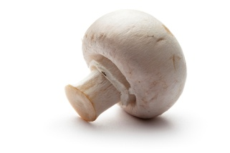
几点思考
Mindful of new tech
One layer system
Cooling under bed
Camera aided pick
Dripping
Robotic picking？。。。

Slide 28
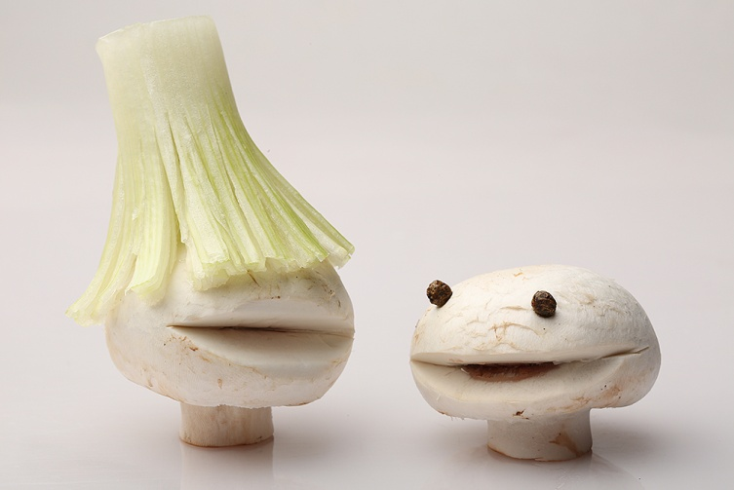
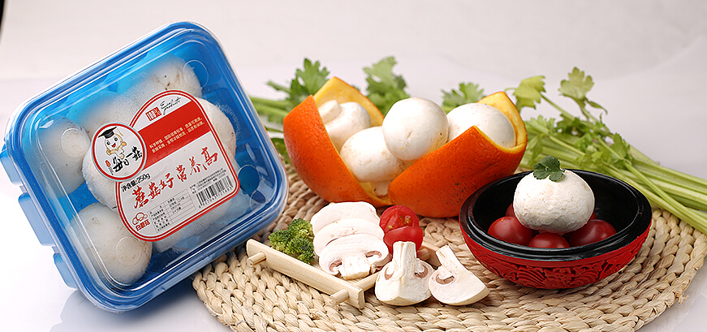
几点思考
Brand building
Quality and brand codependent
Market segregation
Own brand vs Store brand

Slide 29
几点思考
Team building
Energize
Empower
Build ownership by proper incentives
We do not grow mushroom, we grow people
YGMI

Slide 30
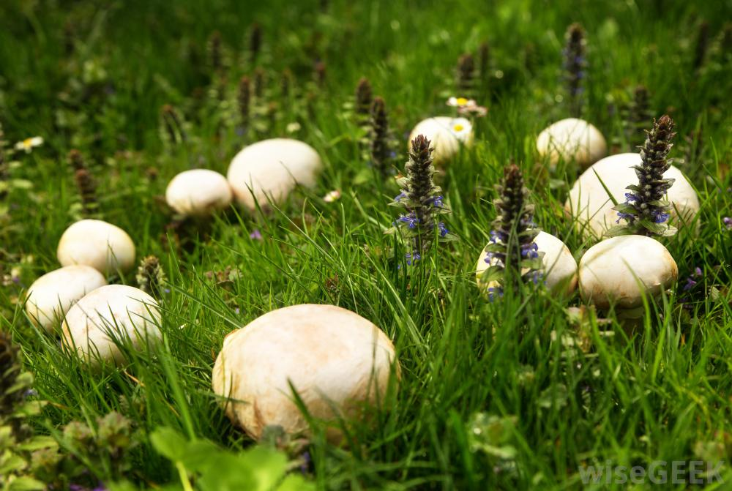
几点思考
A lucky man can stumble upon a treasure while an unlucky one can't even find a mushroom.
-proverb from my hometown
What if we stumble on a treasure of mushroom? Wish everyone find their treasure in mushroom

Slide 31
YUGUAN MUSHROOM
THANK YOU

