Slide 1


Bacterial diseases in mushroom production
András Geösel PhD
associate professor, head of department
Szent István University
Department of Vegetable and Mushroom Growing

Slide 2
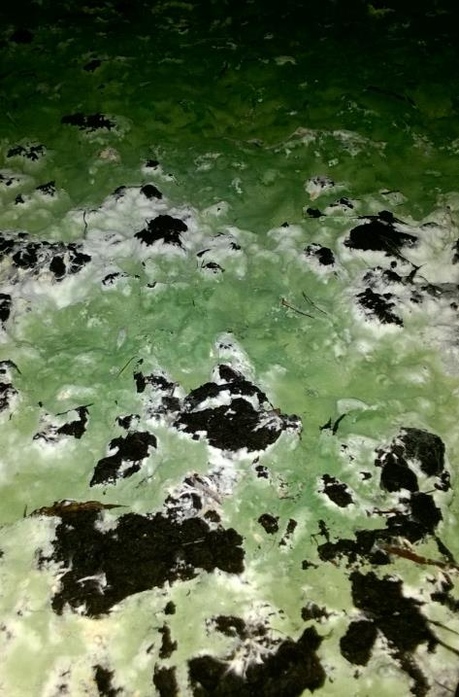
Diseases in mushroom production
Viral diseases
  Not significant and usually rare
Fungal diseases
  Common and widespread
  Cobweb, green mould, wet and dry bubble
  Importance of hygiene
Bacterial diseases
  Local problem
  Hygiene – no help

Slide 3
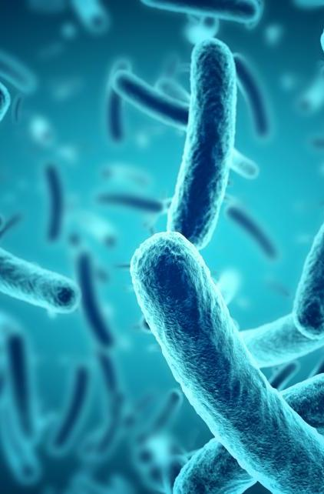
Bacteria on planet
Type of biological cell
Few micrometres in length
The first life forms on Earth
40 million bacteria in a gram of soil
1 million bacteria in a ml of fresh water
Rapid development

Slide 4
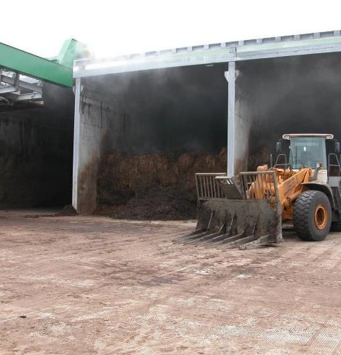
Bacteria in mushroom production
Bacterial succession during compost fermentation
Bacteria present in casing

Slide 5

Effective bacteria in production
Name of bacterium | Effect
Pseudomonas putida | Increased mycelial growth
Pseudomonas putida | Increased primordia formation, increase yield
Scytalidium thermophilum | Faster mycelial growth, increased yield
Bacillus megaterium | Increased yield, inhibition of pathogens
Mycothermus thermophilus | Increased mycelial growth
Bradyrhizobium japonicum | Increased mycelial growth
Pathogenic bacteria in production
Name of bacterium | Effect
Pseudomonas tolaasii, Ps. reactans | Batcerial blotch
Pseudomonas aeruginosa, Ps. tolaasii | Mummy disease
Pseudomonas gingeri | Ginger blotch

Slide 6
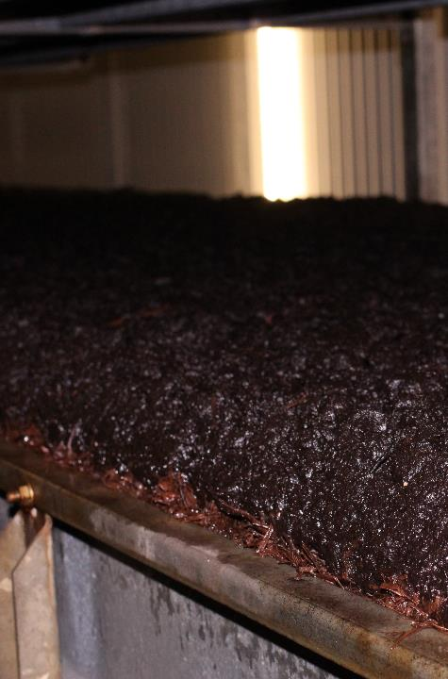
Perfect conditions
Wet environment (casing, compost)
High humidity in the air
Available food source (organic material)
No effect of chemicals (prochloraz-Mn, metrafenone, etc.)
More often in fall-winter (outside air RH% and AH%)

Slide 7
Development of bacteria on mushrooms
Watering
Bacteria
Casing
Compost

Slide 8
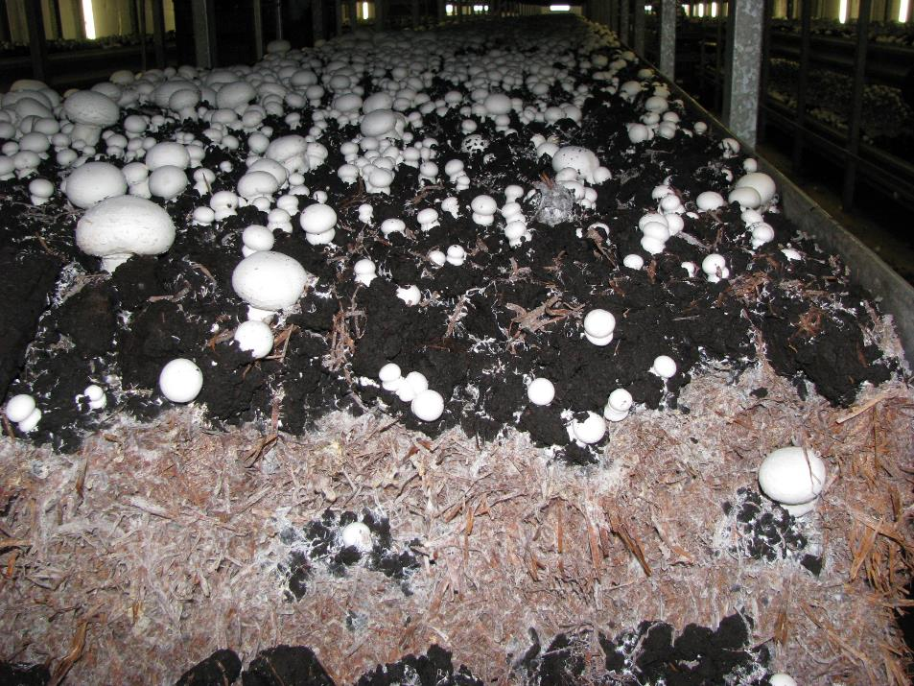

Slide 9
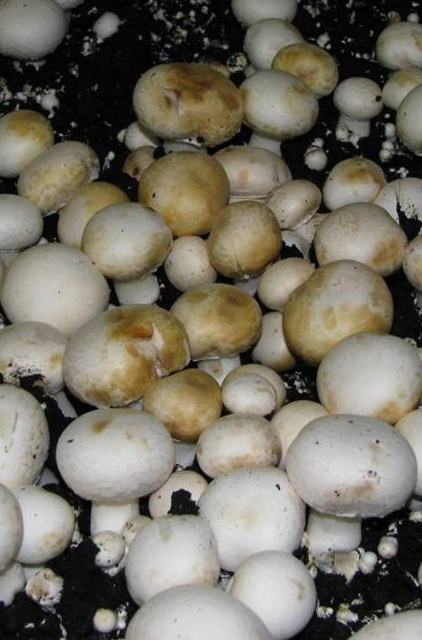
Bacterial blotches
(Ps. tolassii)
Usually in first flush
Always results in crop failure
Reason: poor evaporation
Wet surface on mushroom
Poor airing
May disperse after picking!

Slide 10
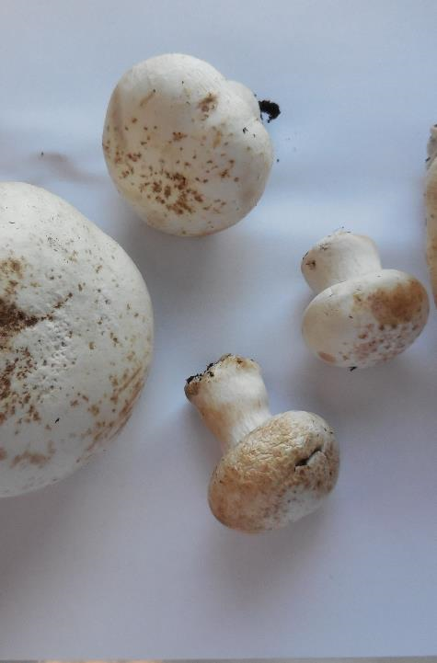
Symptomps
Yellow-brown spots
Few millimeter in diameter
Shallow crater on the mushroom

Slide 11
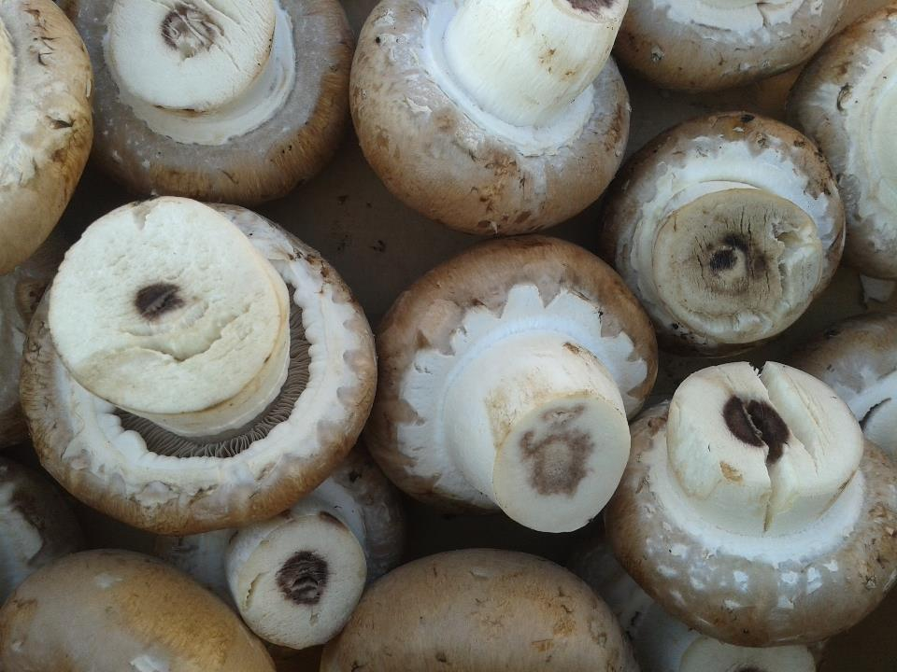
Internal stalk necrosis
(Ewingella americana)

Slide 12
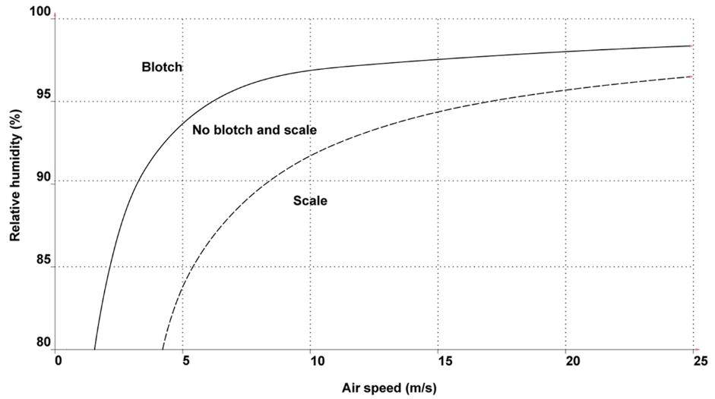

Chart: Fletcher J.T. and Gaze R.H. (2008)

Slide 13
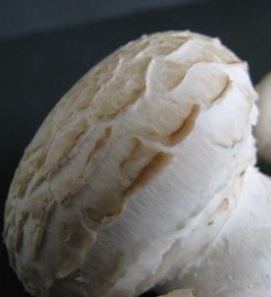
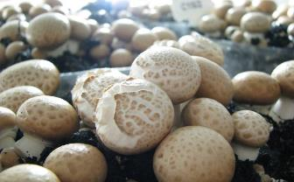
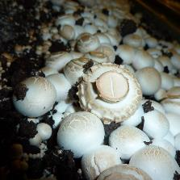
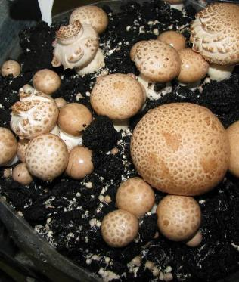
Scaling abiotic disorder

Slide 14
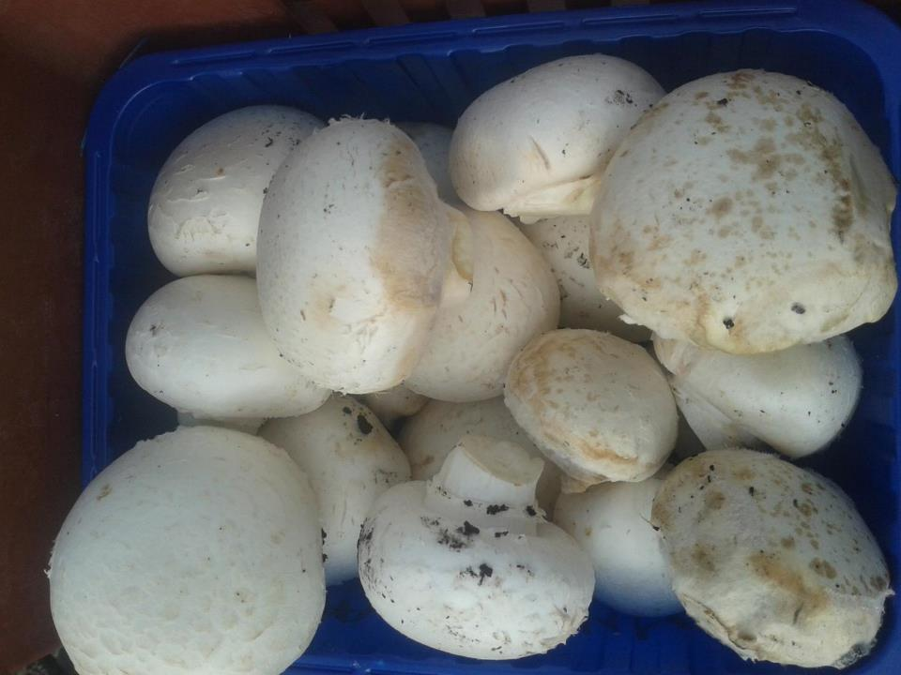
Cobweb spots (Cladobotryium – Dactlyium)

Slide 15
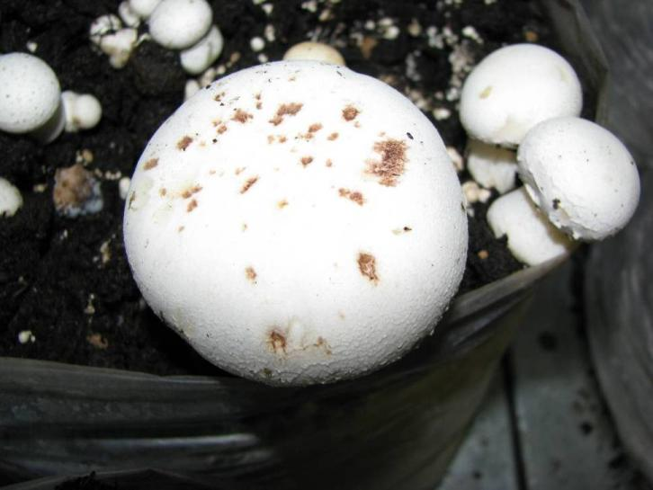
Dry bubble spots (Lecanicillium - Verticillium)

Slide 16
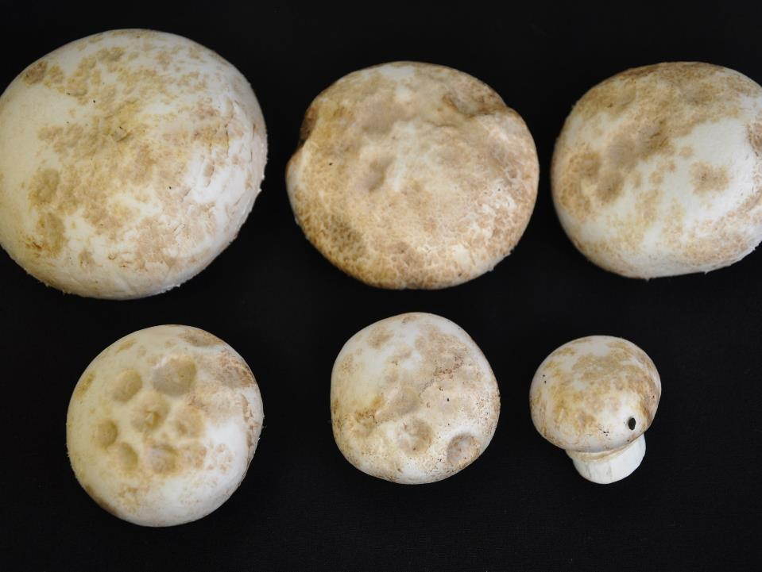
Green mould spots (Trichoderma)

Slide 17
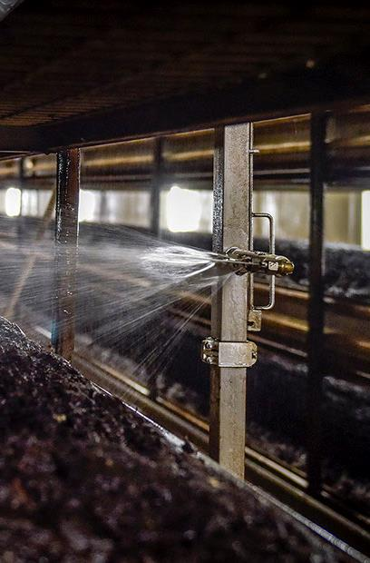
Prevention and treatment
After watering dry surface is needed
Dry mushroom within 2 hours (!)
Increase ventilation speed
More evaporation (compost activity)
Reduced alternating temperature
Between flushes: 0,2% sodium-hypochlorite (NaOCl)
From peahead stage: 0,3% calcium-cloride (CaCl₂)

Slide 18
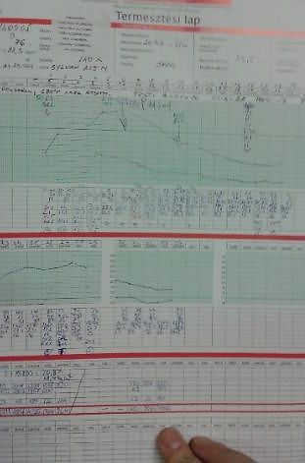
Message
Critical point: irrigation
Always a result of technical failure
Responsibility of the farmer
Accurate measurement (temperature, RH, fan speed)

Slide 19
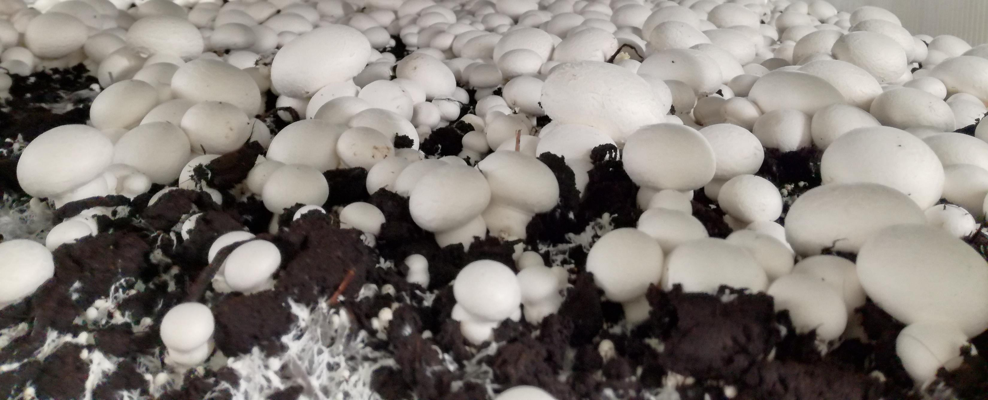
Thank you for your kind attention!
andras.geosel@kertk.szie.hu

