Slide 1
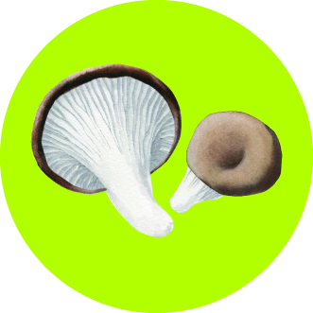
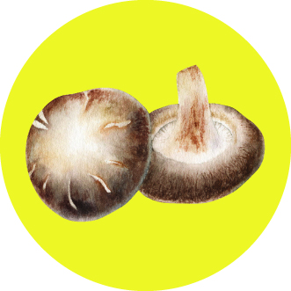
Russian Mushroom Industry: new level of developing

Slide 2
2. Cultivated Mushrooms Production in Russia in 2016-2019* tones
 | 2016 | 2017 | 2018 | 2019* | 19/16 %
Agaricus | 14 265 | 23 790 | 37 320 | 65 000 | 364 %
Pleurotus | 4 909 | 6 157 | 6 323 | 6 500 | 33 %
Exotics | 80 | 141 | 195 | 200 | 150 %
Total | 19 254 | 30 088 | 43 838 | 70 700 | 267 %

Slide 3
3. Production Forecast for 2020, tones

Slide 4
4.Russian Mushroom Industry Structure
Annual Farms Production, tones | 2018 number | 2019 number | 2020 number
10 000 – 15 000 | 0 | 1 | 4
5 000-7 000 t per year | 4 | 4 | 7
1 000 – 3 000 t per year | 4 | 9 | 4
Less then 1 000 t per year | 34 | 43 | 52
Total | 42 | 57 | 67

Slide 5
5. Fresh Mushrooms Import 2016-2018, t

Slide 6
6. Fresh Mushrooms Consumption 2016-2018, t

Slide 7
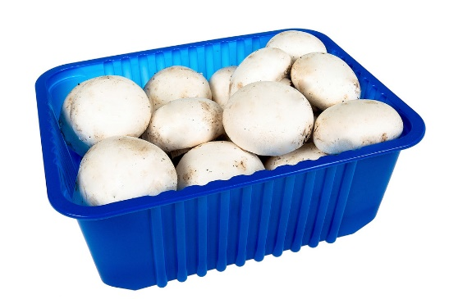
7. Per Capita Fresh Mushrooms Annual Consumption 2016-2018 , gram

Slide 8
8. Growers Prices for Fresh Mushrooms in European Part of Russia 2016-2019 USD/kg

Slide 9
9.Fresh Mushrooms Supply Forecast

Slide 10
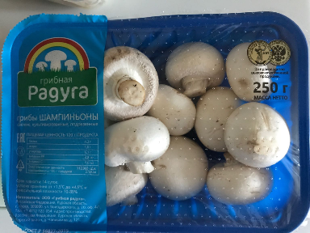
10.Fresh Mushroom Consumption Forecast, grams

Slide 11
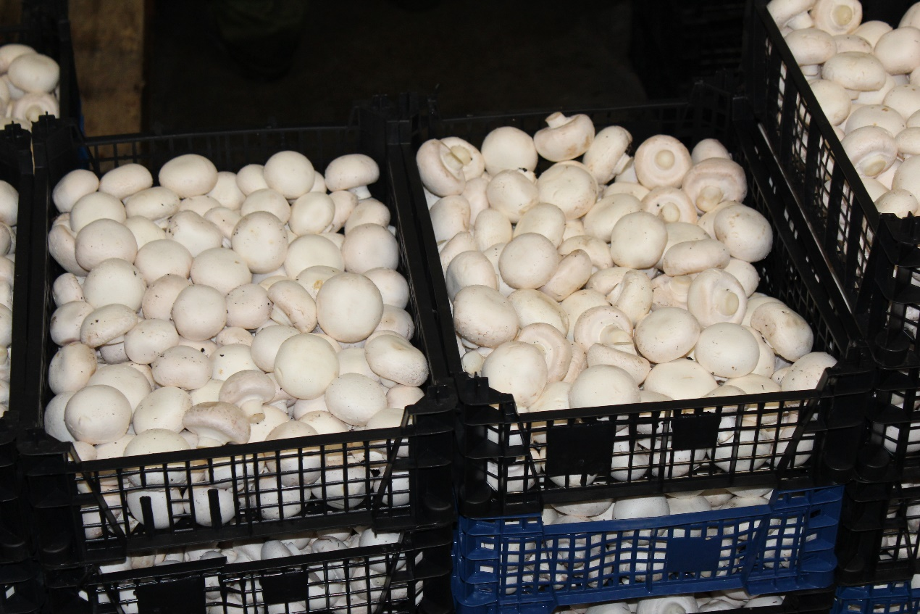
11.Grower Price for Mushrooms in European Part of Russia Forecast 2019-2020 г
2018 2,6 USD
2019 2,4 USD
2020 2,2 USD

Slide 12
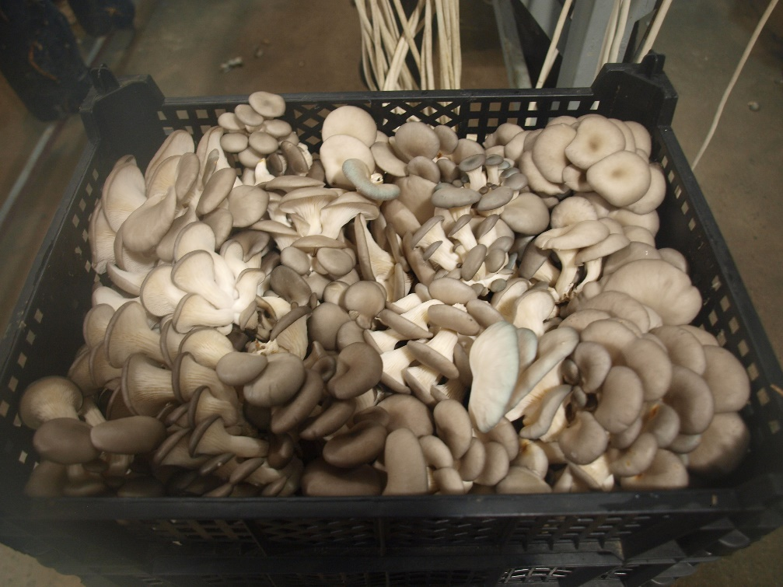
12.Production and prices for Oyster Mushrooms 2017-2020

Slide 13
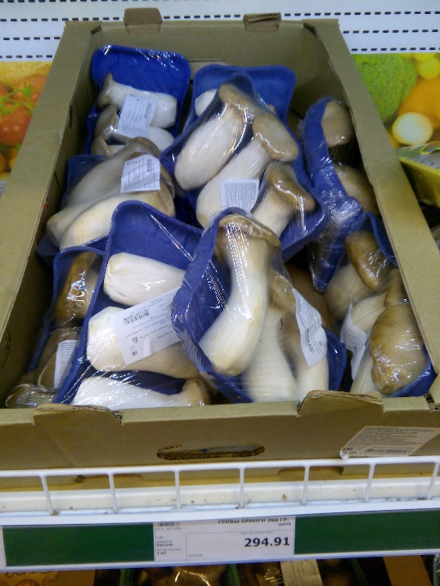
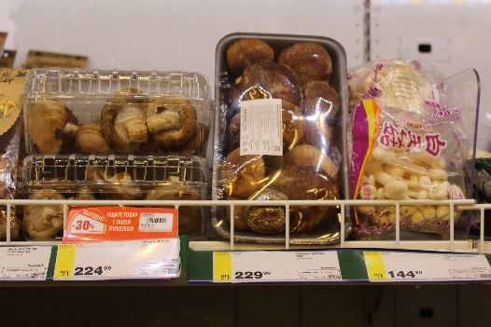
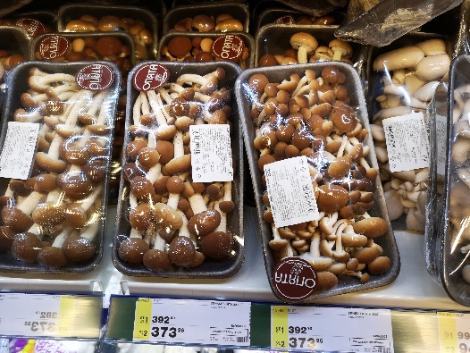
13.Exotic Mushrooms Production, Import and Consumption 2016-2020 .

Slide 14
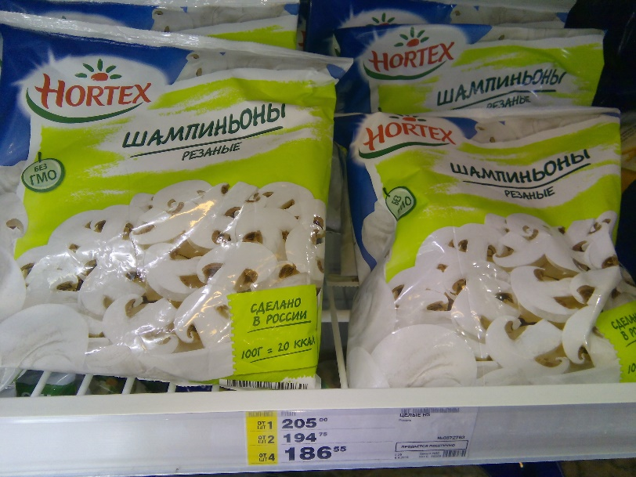
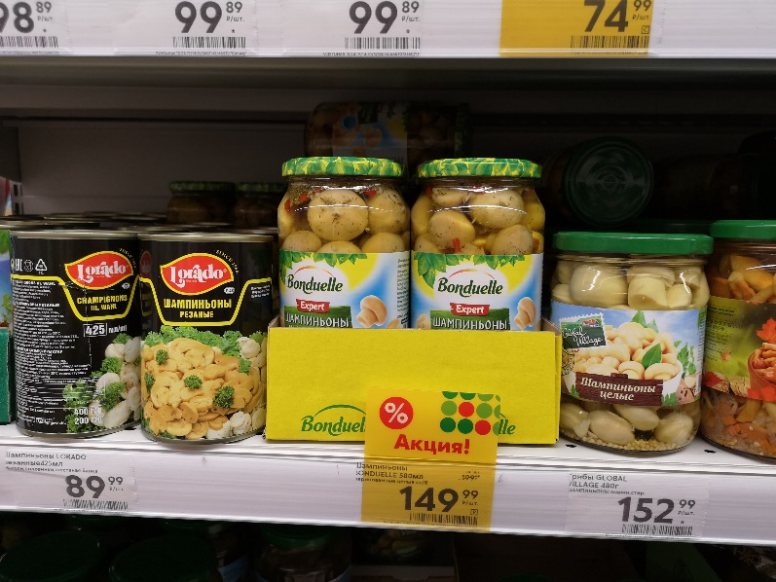
14.Processed Mushrooms Import in 2016-2018 tones

Slide 15
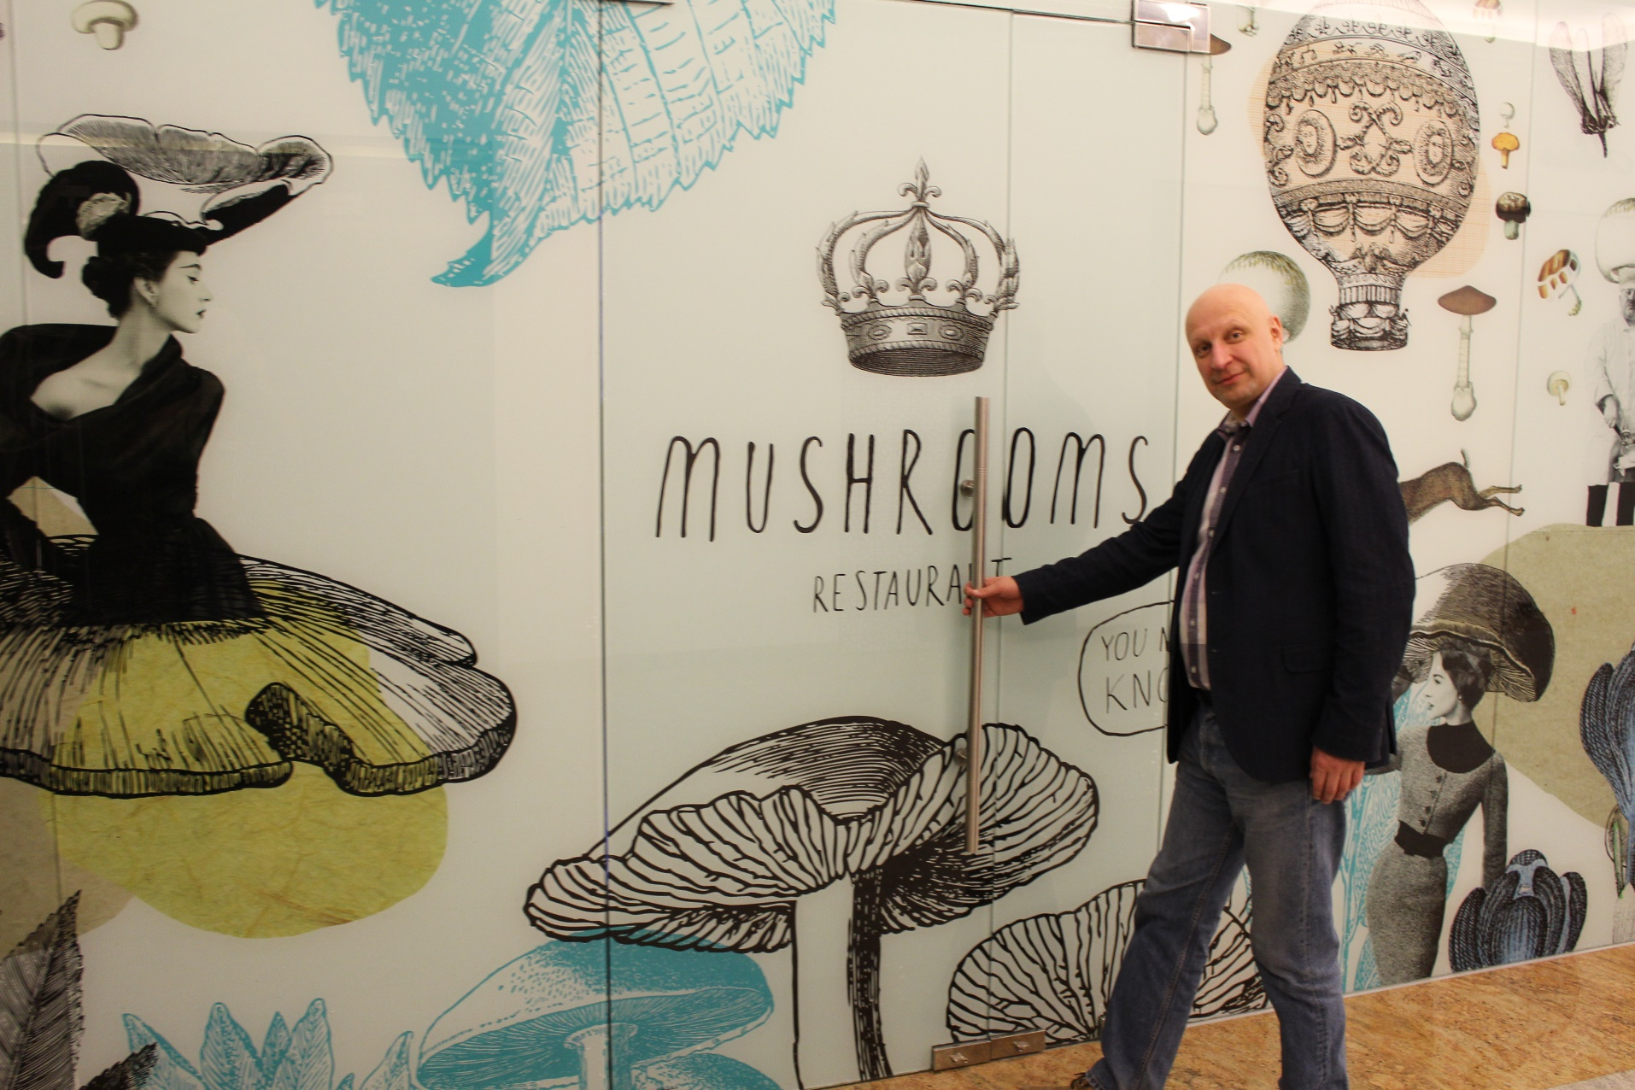
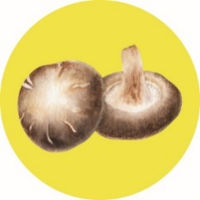
Dziękuję za uwagę!

